Slide 1


presented by
Robert Mayr
Fedora Websites Team
This presentation is under a Creative Commons Attribution ShareAlike 3.0 License.
Please enjoy and share.

Slide 2
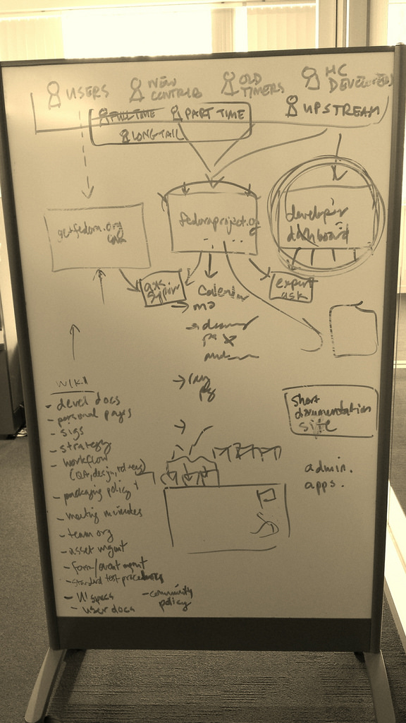
Notes:
Fedora has everything you need to produce awesome mockups.
Fedora needs your help to get better. We need to cultivate a culture in which mockups are used as a design tool much more than we are today.

Slide 3
Plan Components*
'Brochure' Site
User-focused; informational; provides downloads for the three editions.
getfedora.org
User Support Site
Reskin of ask.fedoraproject.org OR more integrated standalone site using ask.fpo API
getfedora.org/help OR help.getfedora.org
Fedora Hubs
Contributor-focused; almost like a Fedora project “intranet”
fedoraproject.org OR hubs.fedoraproject.org
Developer Portal
Upstream (not Fedora) developer-focused, for helping developers using Fedora
developer.fedoraproject.org
Spins Revamp
Redesign the spins website to match the new brochure site; split out different types of spins into their own sites.
spins.fedoraproject.org labs.fedoraproject.org arm.fedoraproject.org
* Some of this plan originated as long ago as the 2009 website revamp. See http://ur1.ca/ncots

Slide 4
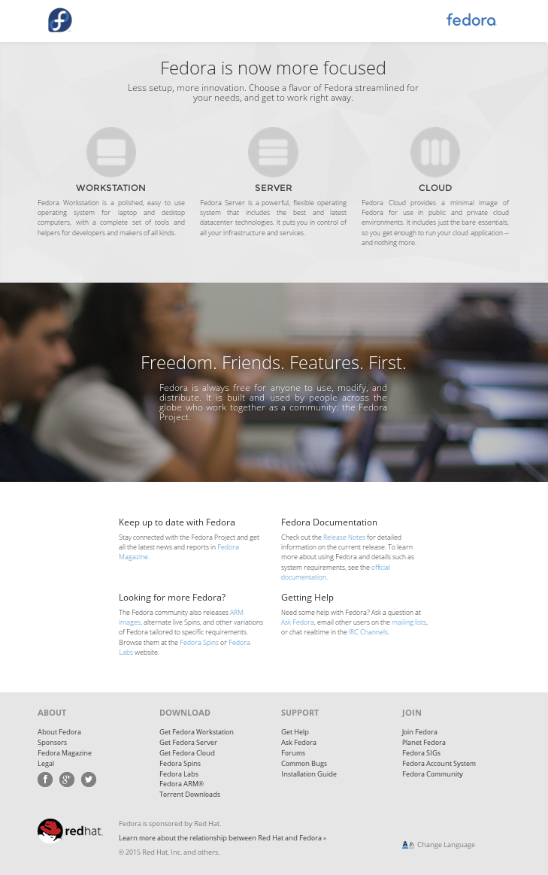
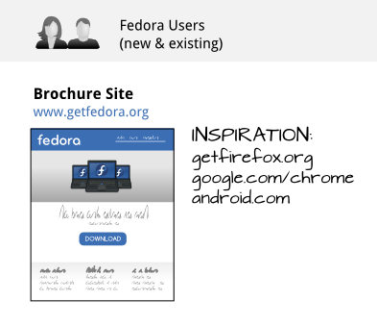
Brochure Site
A Fedora website to allow new and existing users to learn about Fedora (the Operating System) and to be able to download it.
We call it a ‘brochure’ site because it’s informational and aimed at people who have never heard of Fedora before and want to learn more about what it is. It’s also aimed at people who know what Fedora is and use it, but who simply want to download it and get on with their lives. It’s not primarily aimed at contributors.

Slide 5
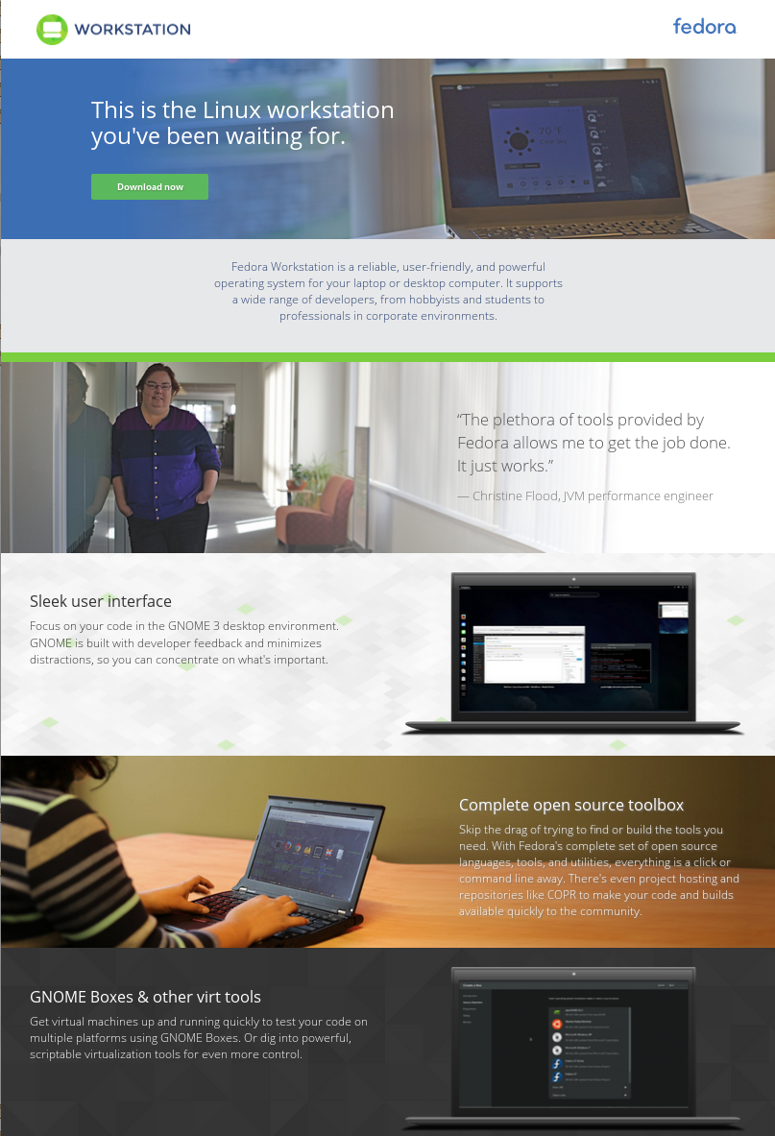
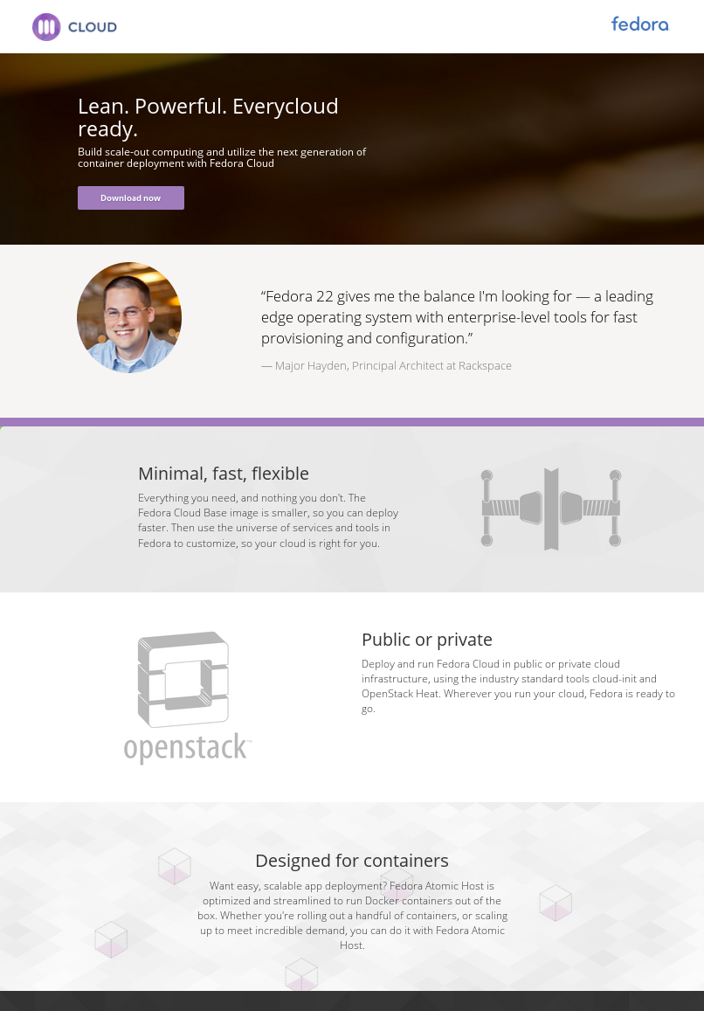
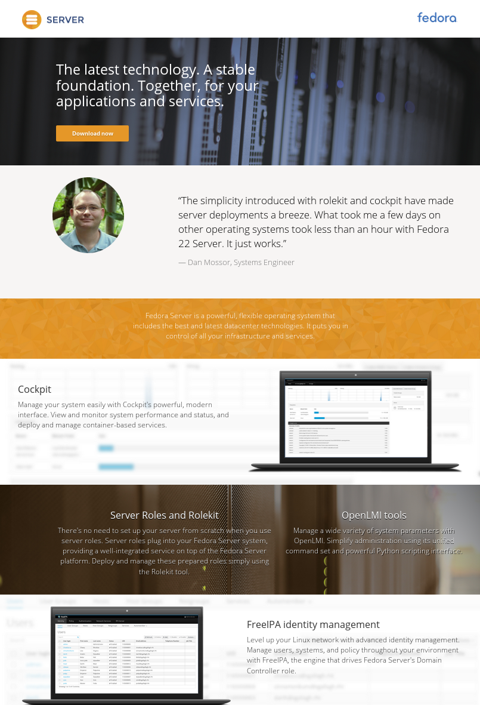
Brochure Site

Slide 6
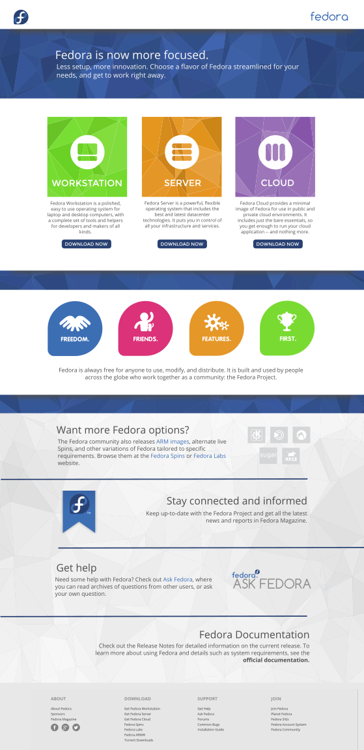
Brochure Site: Status
The new Fedora brochure site launched with Fedora 21.
We're mostly in maintenance mode now; the general site layout is set and we will make additions / changes as the working groups want to update information about their Fedora editions.
Meghan Richardson, the Fedora UX intern this summer, did a visual redesign of the front page (shown on the left.)

Slide 7
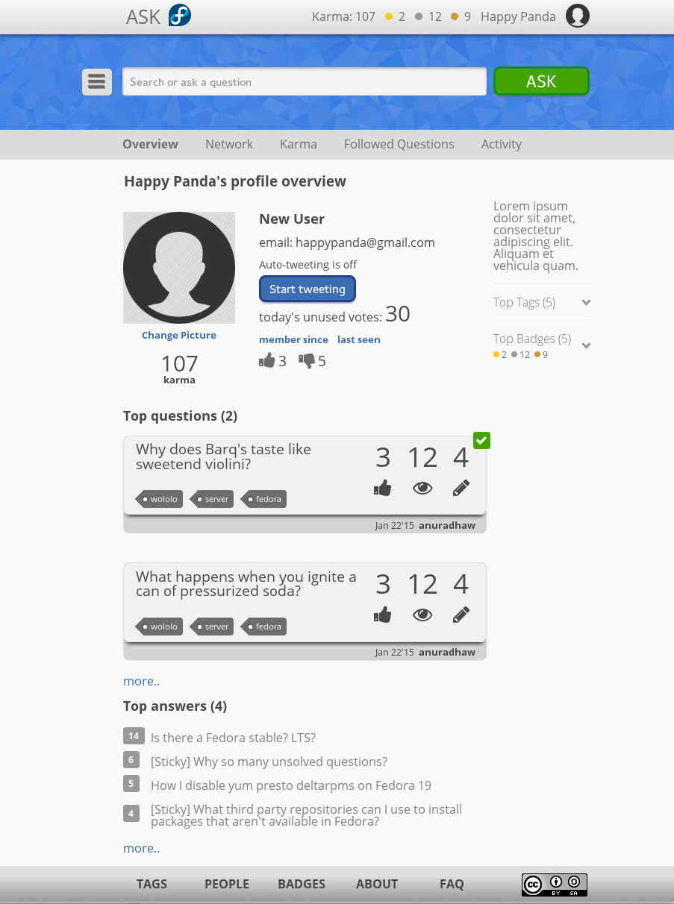
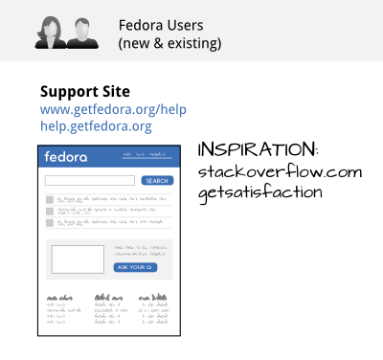
User Support Site
The idea for this site is to be targeted primarily at Fedora users.
It could be a reskin of ask.fpo (although a UX redo is already underway) or involve using ask's API to make a more beginner-friendly front end to ask.fpo.
Later on, Fedora desktop integration with the support site could be cool, so you can ask questions and get notifications when answers to your questions are available from the desktop.

Slide 8
User Support Site: Status
There is currently a Google Summer of Code project with Fedora to revamp ask.fedoraproject.org's UX (Anuradha Welivita is working on this with mentors Sarup Banskota and Suchakra Sharma.)
Part of the GSoC work involves a new skin for ask.fedoraproject.org. However, that work isn't in sync with the Fedora.next websites redesign work. There are a couple of options here, then:
- Make minor tweaks to the new skin of ask.fedoraproject.org to fit the general new
Fedora.next look and feel (it's not too far off.)
- Develop a more simplified help portal integrating
Fedora's documentation alongside articles from ask.fpo using the ask.fpo API.
No effort is currently being put forth towards either approach at this point in time.

Slide 9
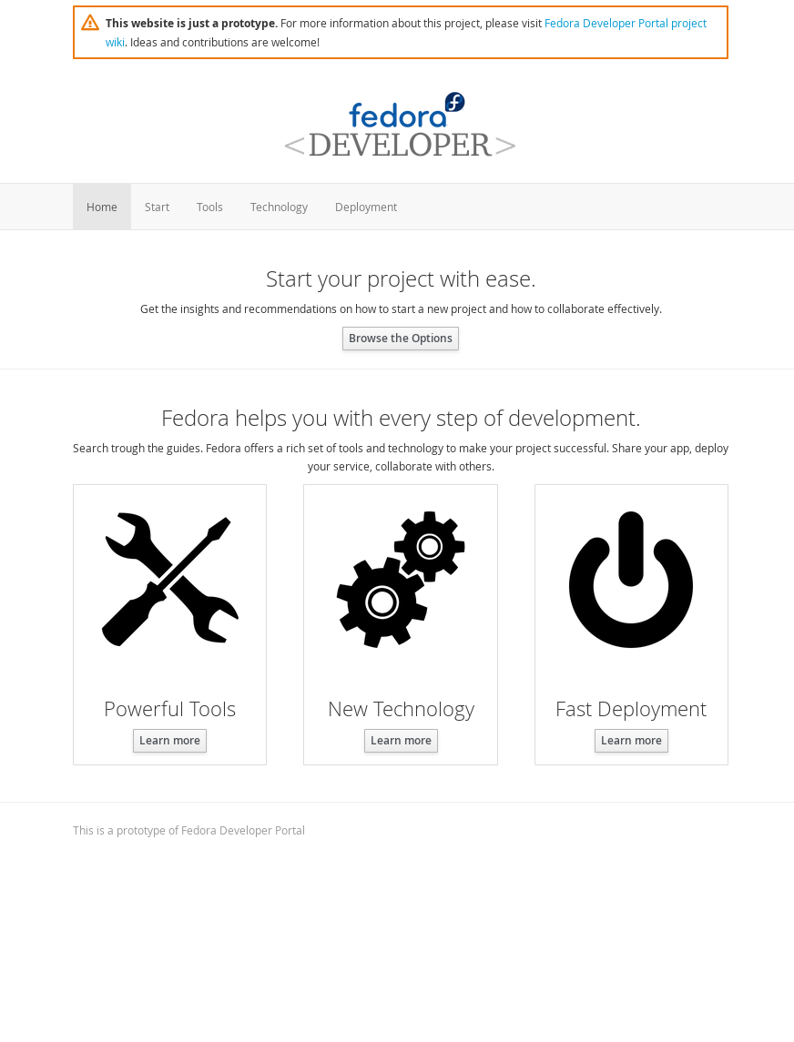
Developer Portal
The idea for this site is to be targeted primarily at developers interested in using Fedora as a development platform. It will provide information about tools, technology, and other developer-centric features of Fedora.
More at: fedoraproject.org/wiki/Websites/Developer

Slide 10
Developer Portal: Status
A team of contributors lead by Petr Hracek is actively working on the design and development of this portal. They plan to launch the first version in mid September 2015. https://github.com/developer-portal/content https://github.com/developer-portal/mockups

Slide 11
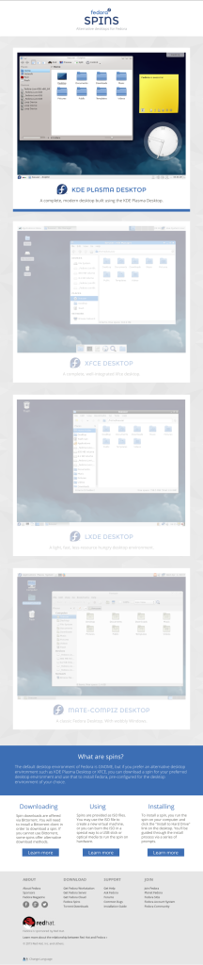
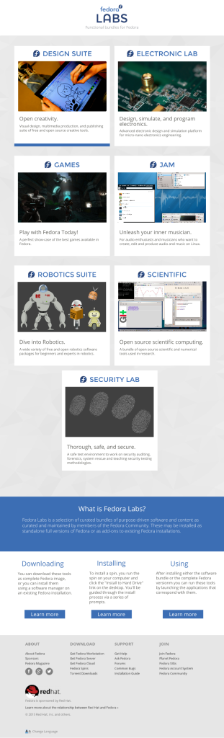
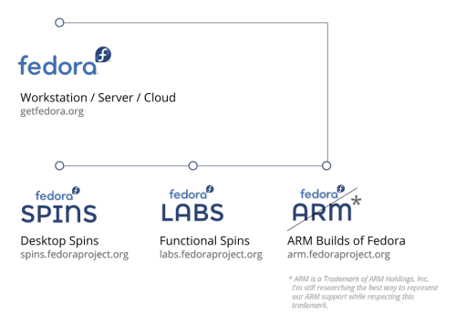
Spins Revamp
The websites team made a decision to split the desktop spins away from the functional spins.
Functional spins will be housed at a new site catered specifically for them: labs.fedoraproject.org.
ARM builds will also have their own one-page site with references to important documentation and the Fedora ARM community as well.

Slide 12
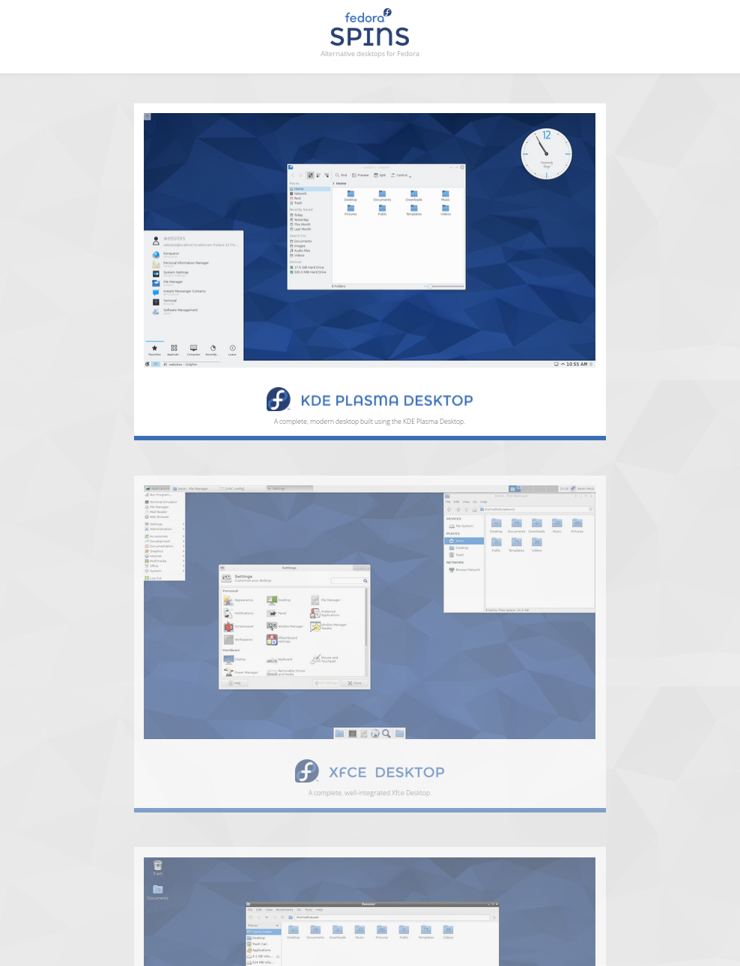
spins.fedoraproject.org
The spins.fedoraproject.org site now focuses exclusively on desktop spins. Each desktop spin, as a part of this design, has its own section of the site with screenshots, a basic description, download area, and feature highlights, as well as support information for that particular spin.

Slide 13
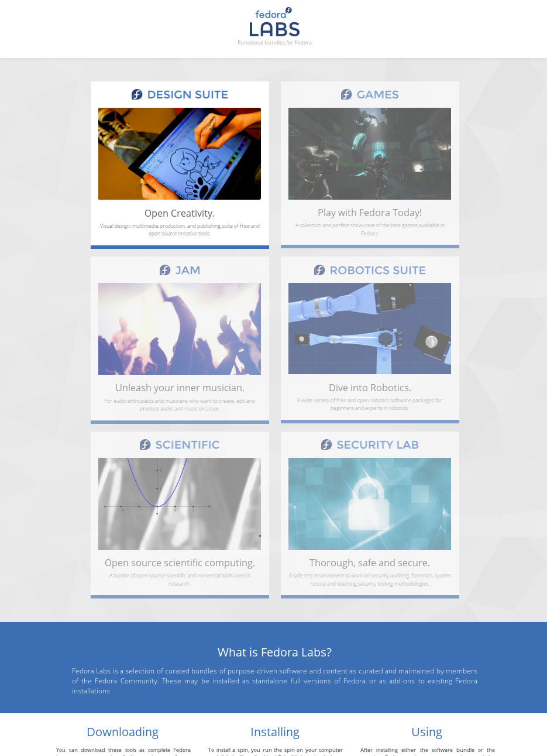
labs.fedoraproject.org
The labs.fedoraproject.org site now focuses exclusively on functional spins – spins designed around a particular functional purpose or goal rather than centered around showcasing a particular desktop environment.
Each labs spin, as a part of this design, has its own section of the site with screenshots, a basic description, download area, and feature highlights, as well as support information for that particular spin.

Slide 14
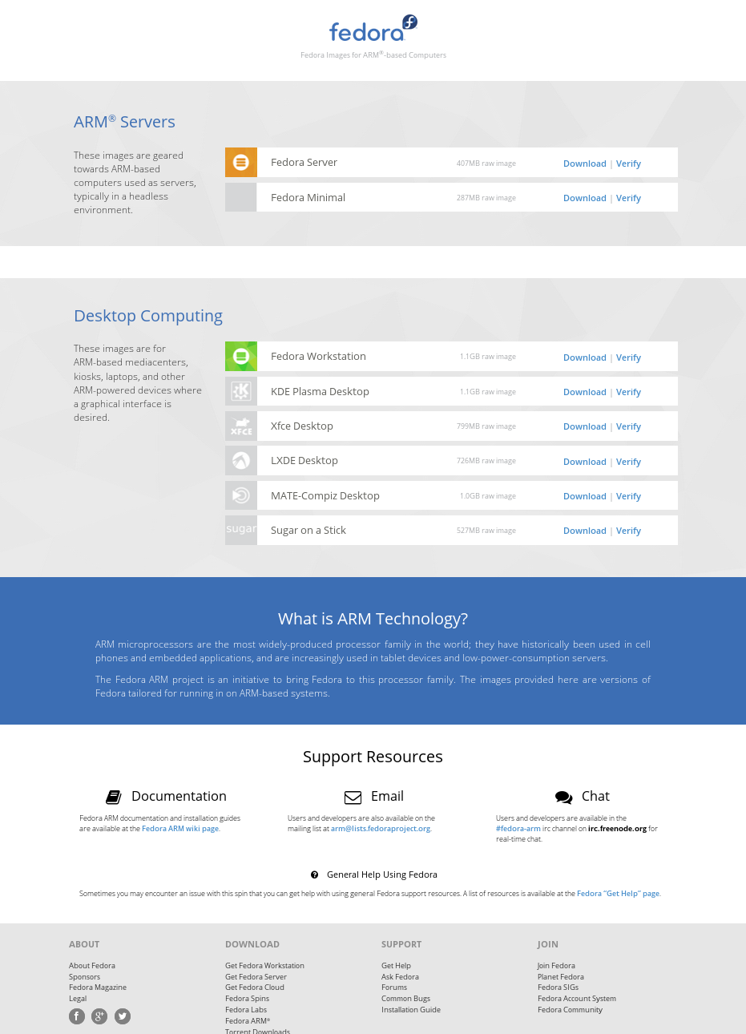
arm.fedoraproject.org
The arm.fedoraproject.org site is a single-page mini-site that makes all Fedora Images for ARM®-based Computers available on a single page, split into two general categories.
It also provides links to Fedora-specific ARM support resources.

Slide 15
Spins Revamp: Status
We're mostly in maintenance mode now; the general site layout is set and we will make additions / changes as spins change / are updated.

Slide 16
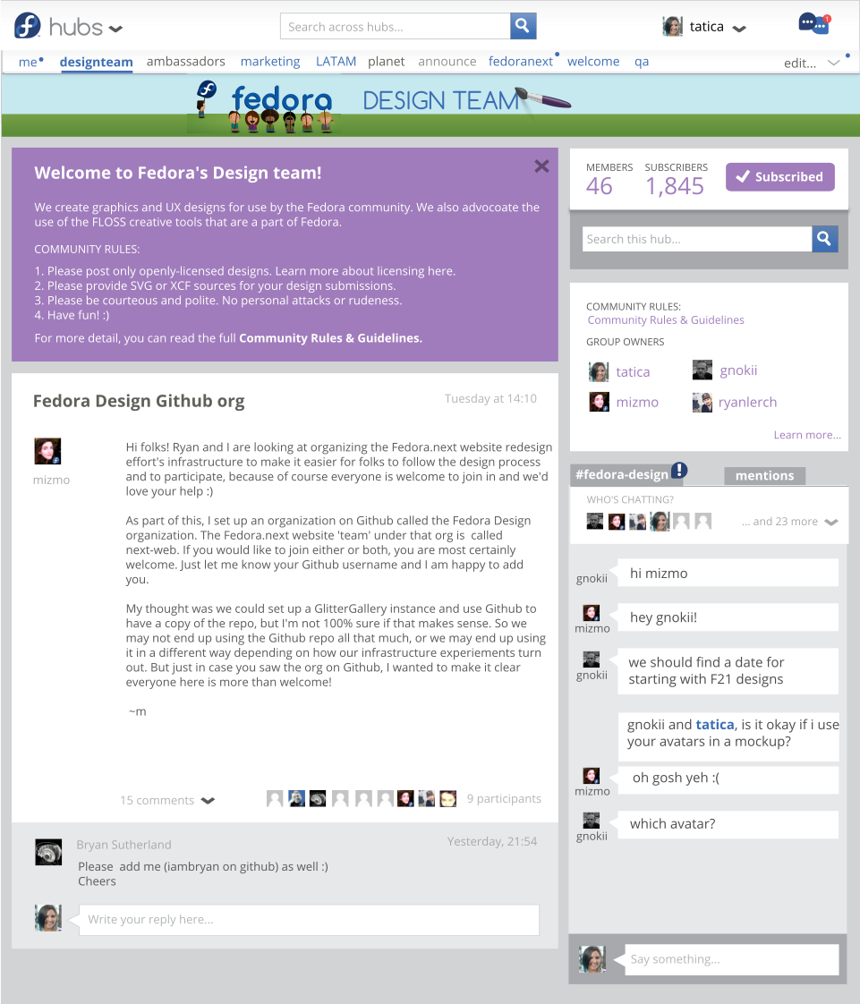
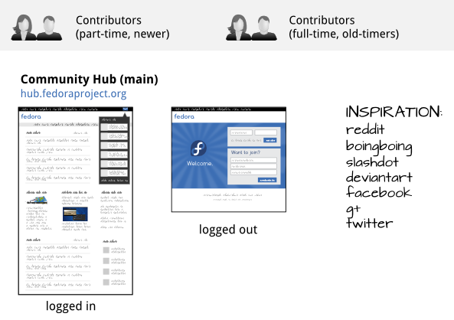
Fedora Hubs
The idea for this site is to be targeted primarily at Fedora contributors.
It’s an ‘intranet’ page for the Fedora Project. You work on all these different projects in Fedora, and it’s a single place you can get information on all of them as a contributor.
It’s also a social network for Fedora contributors. One place to go to keep up with everything across the project in ways that aren’t currently possible. We have a lot of places where teams do things differently, and it’s a way to provide a consistent contributor experience across projects / teams.

Slide 17
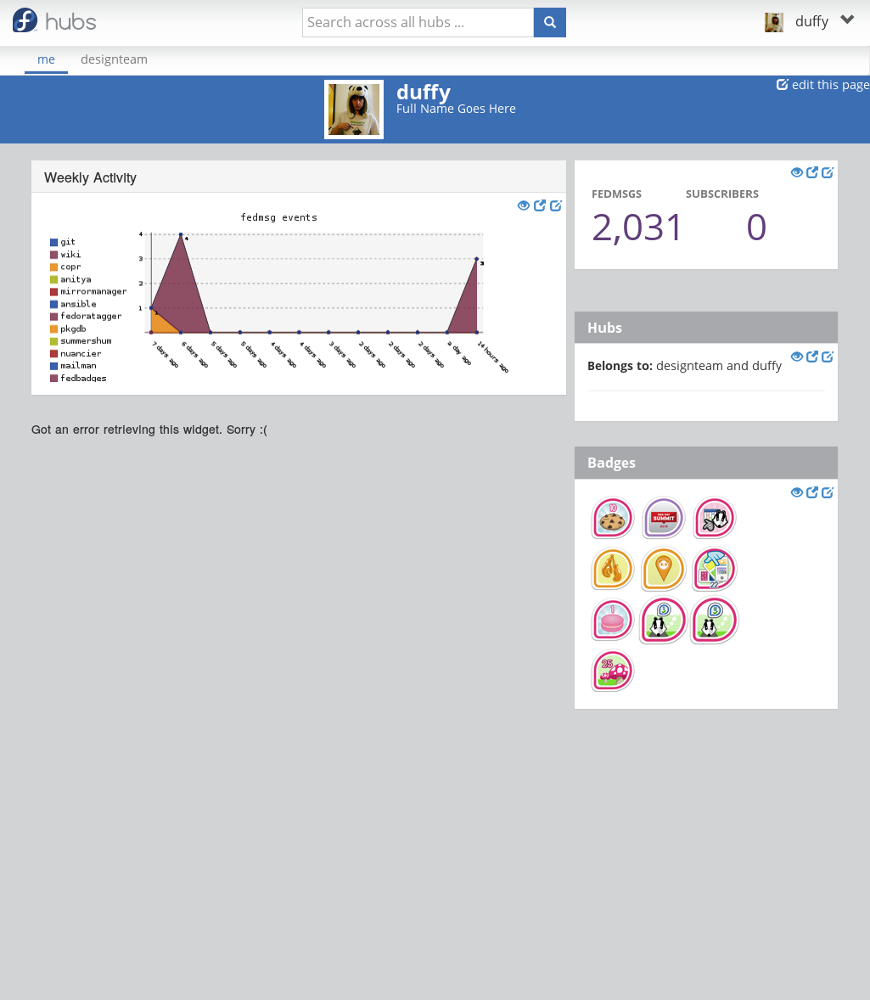
Fedora Hubs: Status
Design and development on Fedora Hubs has been active all of this summer, with Meghan Richardson putting forth a huge effort on the UX design and Ralph Bean working on the development front. (Screenshot of prototype shown, left.)
Development: https://pagure.io/fedora-hubs
Design: https://pagure.io/fedora-hubs/issues & https://github.com/fedoradesign/fedora-hubs

Slide 18
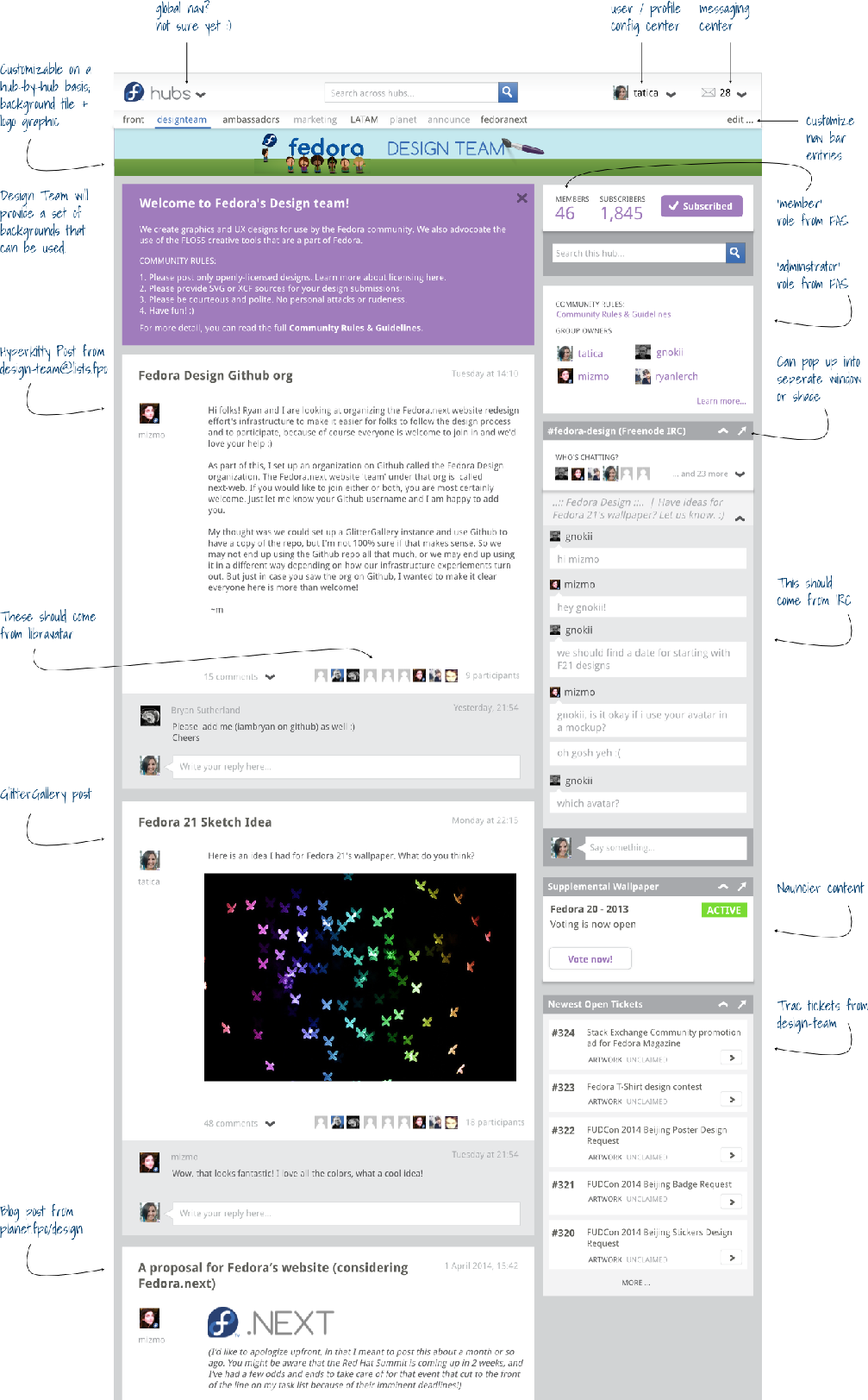
Process
FIRST MOCKUP
April 16, 2014
First full mockup + visual
design for Fedora Hubs
posted to Planet Fedora.
Feedback continues to be favorable; excitement
builds.
- blog.linuxgrrl.com/2014/04/16

Slide 19
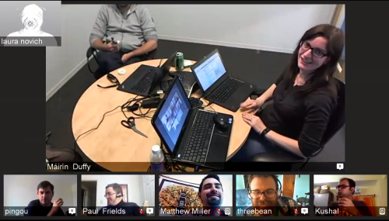
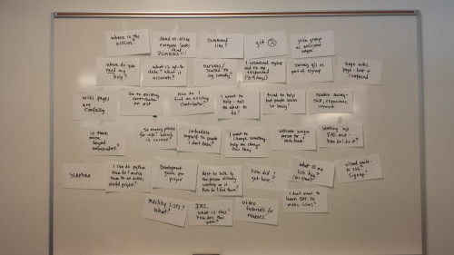
Process
ENABLING NEW CONTRIBUTORS BRAINSTORM
March 25, 2015
Via an open call, we gathered a group of folks representing many teams across Fedora and had a formal brainstorm session on how to enable new contributors, mapping new contributor needs to potential Fedora Hubs features.
- blog.linuxgrrl.com/2015/03/25

Slide 20
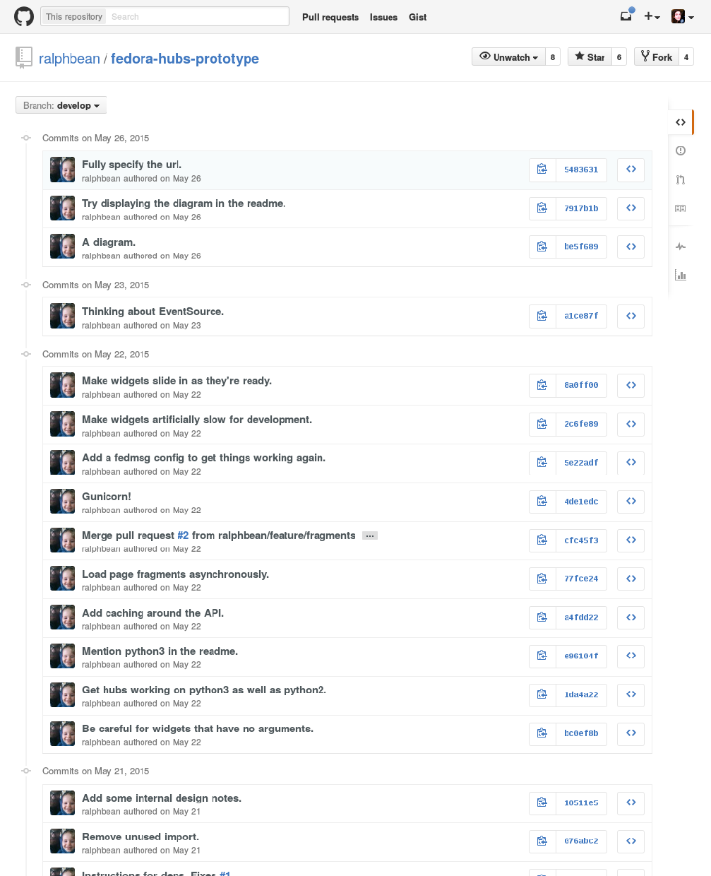
Process
PROTOTYPING BEGINS
April 13, 2015
Threebean starts hacking on a prototype for Fedora Hubs, which later moves from github to pagure.io.
- github.com/ralphbean/fedora-hubs-prototype

Slide 21
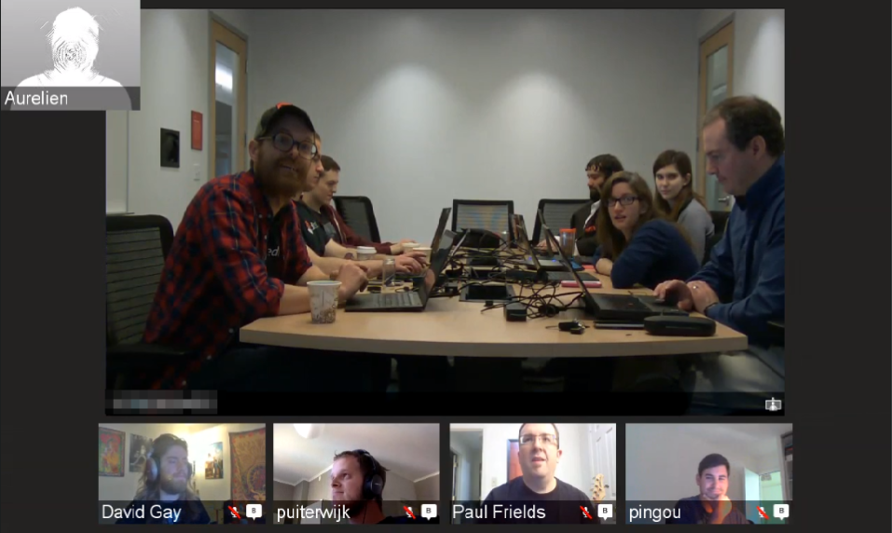
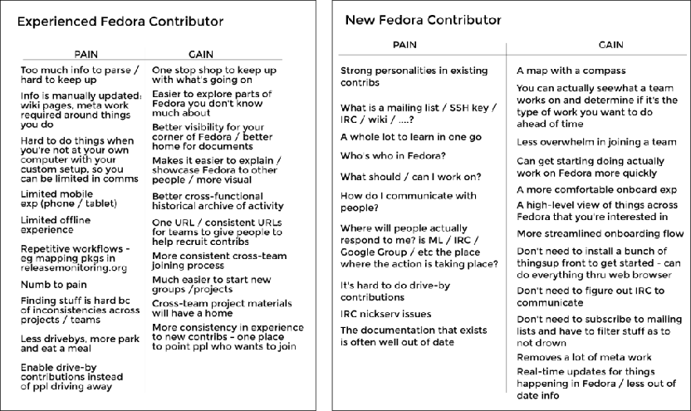
Process
FEDORA HUBS HACKFEST
June 4, 2015
We glom onto the front end of the Fedora Release Engineering FAD and have a hackfest for hubs, with design thinking games, a prototype demo, and full mockup review – plus some hacking, of course. :)
- blog.linuxgrrl.com/2015/07/01

Slide 22
More mockups, more prototype development…
Let's see the progress!

Slide 23
UI Mockups
Individual vs team-based hubs
Widget-based approach
Many more mockups were produced than are shown here, these are simply a small selection
  https://github.com/fedoradesign/fedora-hubs
  https://meghanrichardson.wordpress.com/

Slide 24
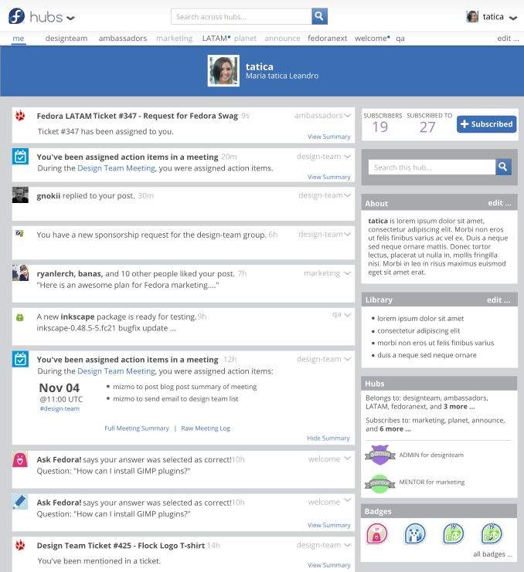
Personal Hub Stream
Main content collects notifies across Fedora apps
Right sidebar contains permanent widgets with user info

Slide 25
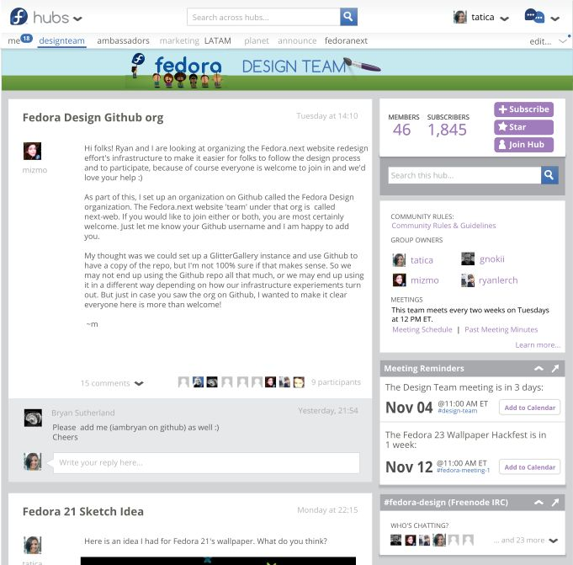
Team Hub
Main content collects discussions and contributions
Right sidebar contains widget tools for communication and coordination

Slide 26
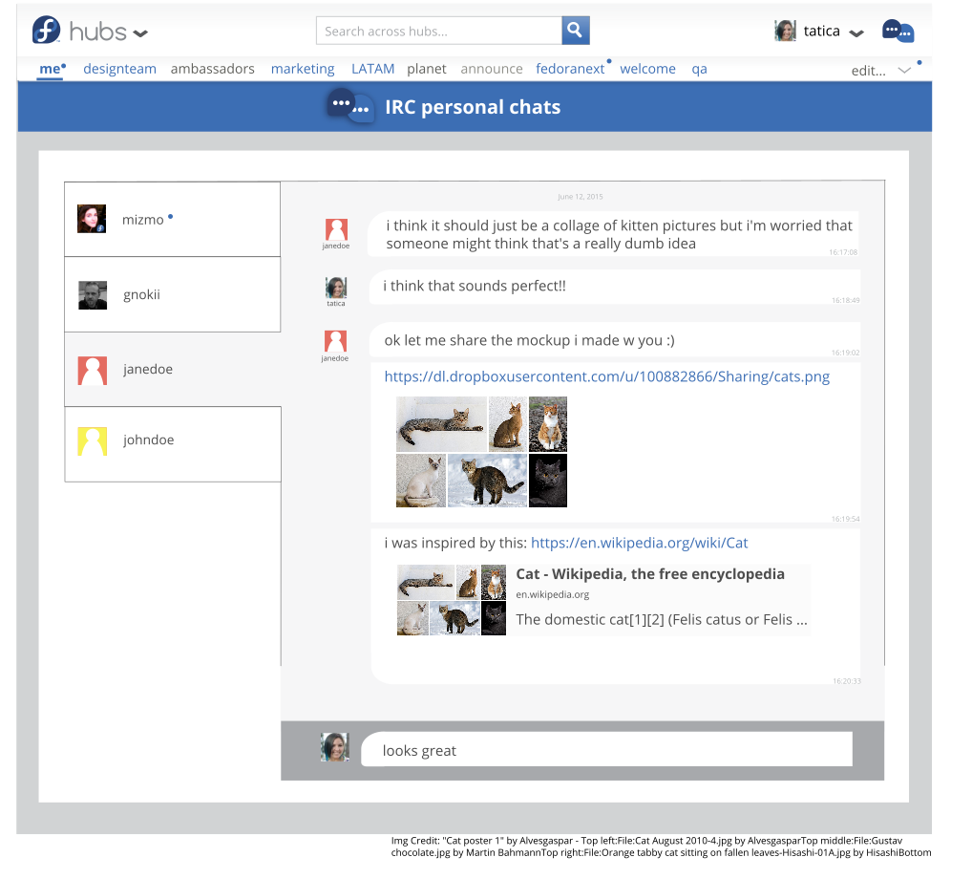
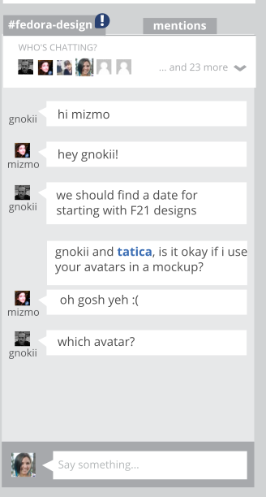
IRC on Hubs
Support for IRC PMs
Handles mentions in hub group chat

Slide 27
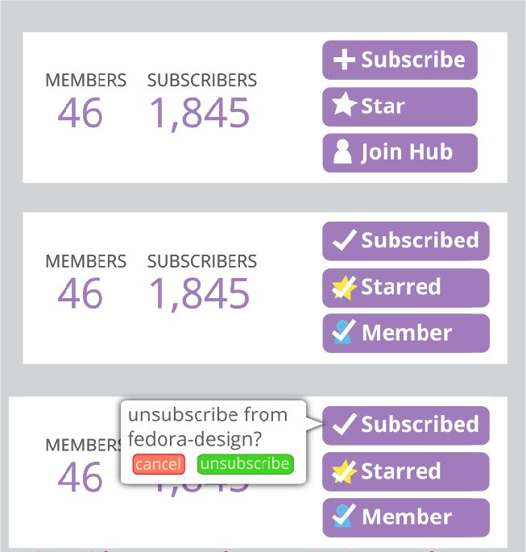
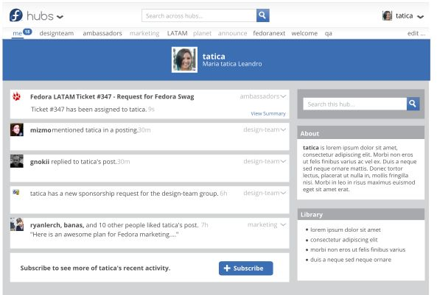
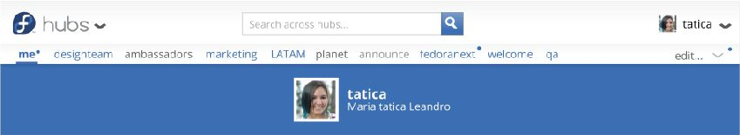
Hub Membership
Subscribing vs Membership vs Starring
A user's personal content is also subscribe-gated

Slide 28
The Prototype
Currently in progress
The backend data comes from fedmsg; the frontend application layer is Flask (with the potential to also use AngularJS in the future)
Runs in a virtualenv for now
  localhost
  https://pagure.io/fedora-hubs/blob/develop/f/README.rst

Slide 29
Next Steps
Interviews across multiple Fedora teams to ensure more specific needs are met
Continuing to develop the prototype
Beginning to test the prototype on potential users

Slide 30
Getting Involved
Design mockups are in Github:
  github.com/fedoradesign/fedora-hubs
Development is in Pagure ('develop' branch):
  pagure.io/fedora-hubs

Slide 31
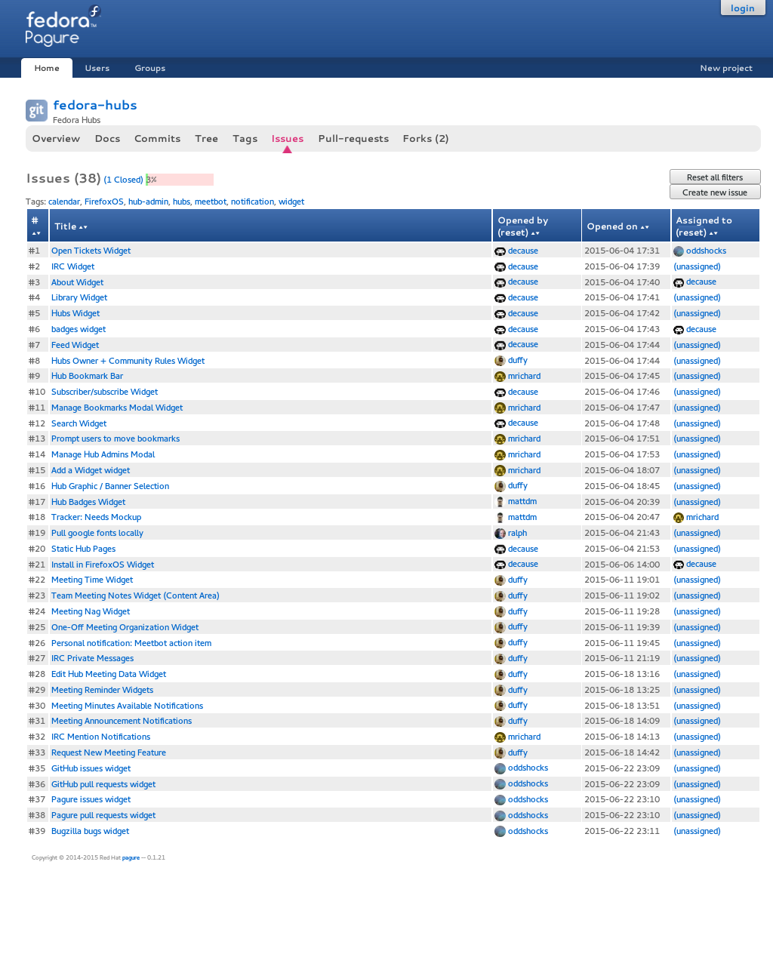
Getting
Involved
We use the Pagure “Issues” tracker to track atomic features that need to be developed. Many of these are individual widgets that are nicely-sized chunks of work to pick off to get involved in development.
The issue tickets themselves also serve as 'specs' for the features they are for, so any design suggestions or help can be provided there, too.
pagure.io/fedora-hubs/issues

Slide 32
GET INVOLVED WITH FEDORA WEBSITES!
#1 Tutorial on Getting Started http://fedoraproject.org/wiki/Websites/ShowUs
#2 Mailing List https://lists.fedoraproject.org/mailman/listinfo/websites
#3 IRC
#fedora-websites on irc.freenode.net
#fedora-hubs on irc.freenode.net
Notes:
Fedora has everything you need to produce awesome mockups.
Fedora needs your help to get better. We need to cultivate a culture in which mockups are used as a design tool much more than we are today.

Slide 33

Questions?
This presentation was created through the exclusive use of free software and content:
Fedora 22 • OpenOffice.org Impress • Inkscape • GIMP
Creative Commons licensed artwork • Openly-licensed fonts
This presentation is under a Creative Commons Attribution ShareAlike 3.0 License.
Please enjoy and share.
Cartoon credit: María 'Tatica' Leandro, Creative Commons Attribution 3.0

